Slide 1
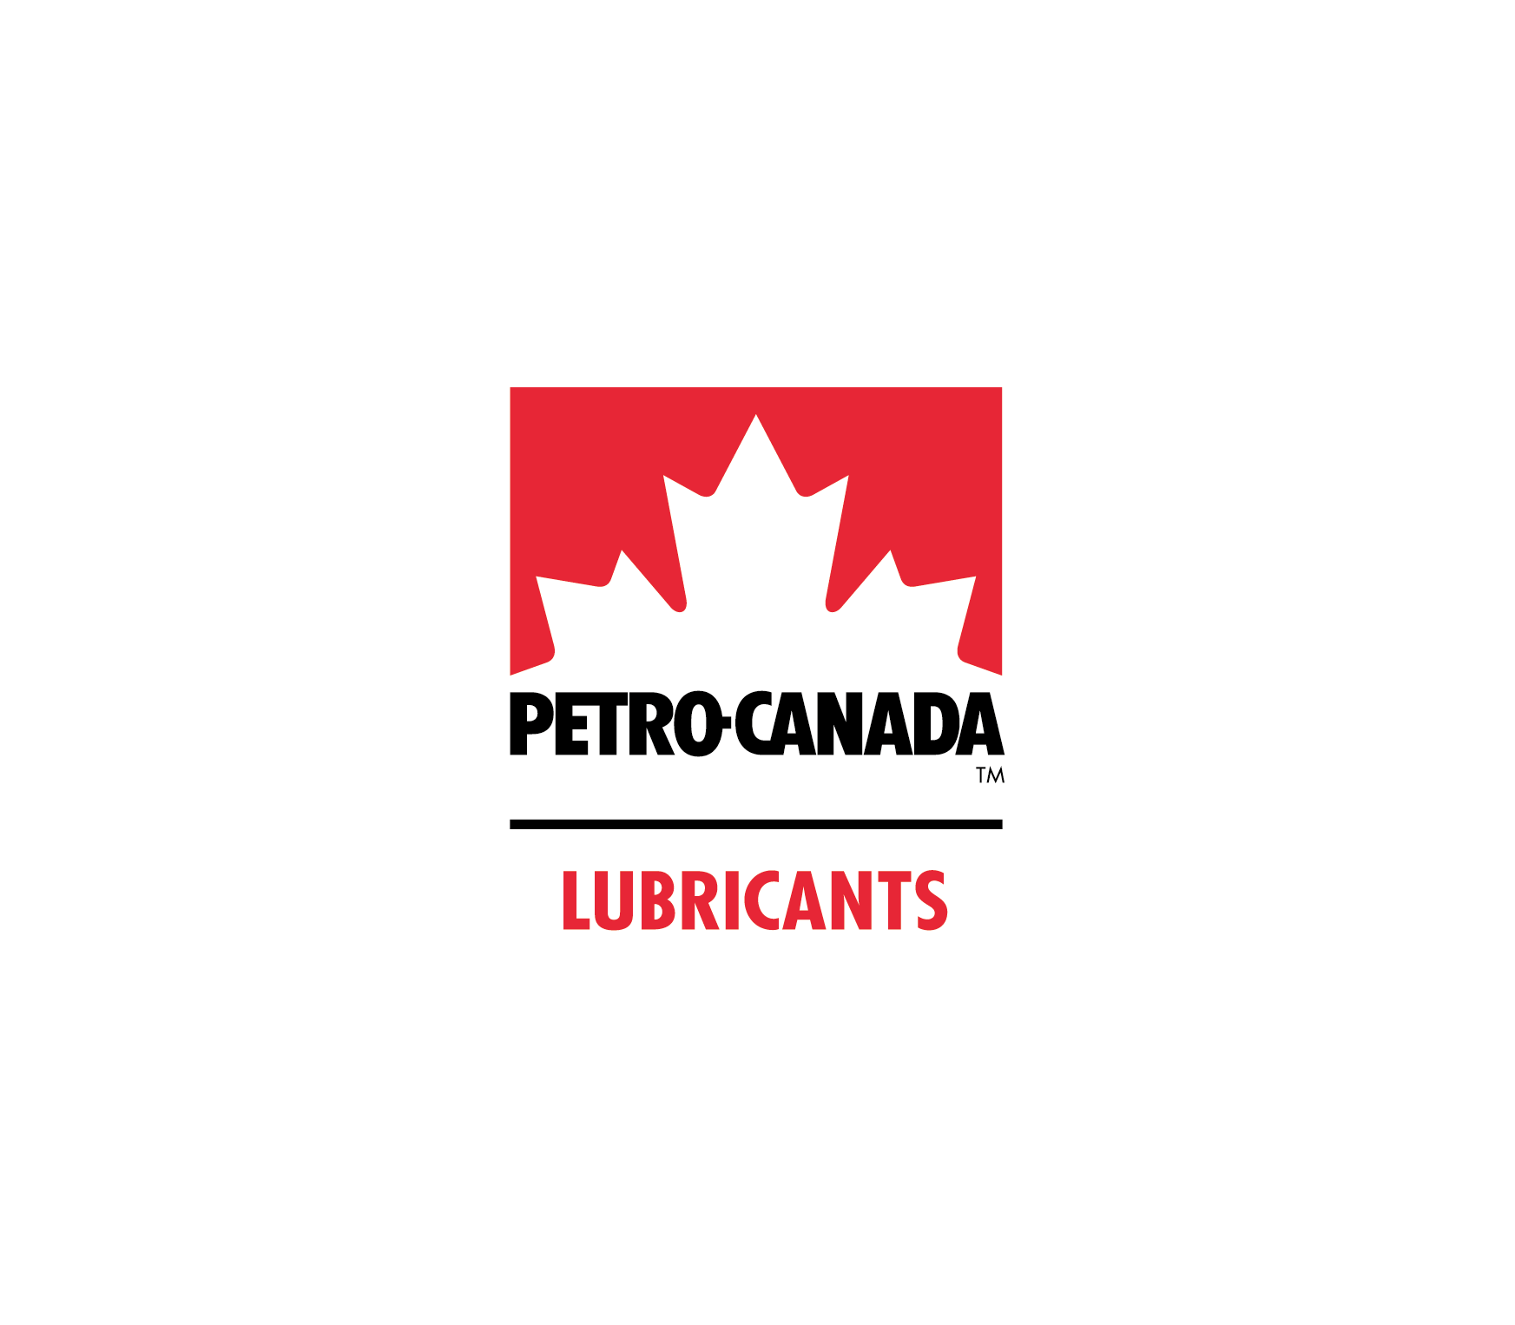

FOULING IN INDUSTRIAL HEAT EXCHANGERS​
FoulX : Dorothy Wan, Aliana Andres, Ricky Fan, Curtis Rhodes
1

Slide 2
Table of contents
01
02
03
04
05
Project Context
Design Progress to Date
Technical Analysis
Impacts Analysis
Remaining Work
2

Slide 3
01
Project Context
3

Slide 4
Project Context
Speaker: Aliana
Problem Statement: Fouling within heat exchangers used in the oil and gas industry results in a decrease of thermal efficiency and affects chemical manufacturing processes globally. The goal of this project is to decrease the amount of fouling while maintaining performance efficiency.
Needs
Stakeholders
To tackle this problem, one can focus in reducing the amount of fouling building up in the heat exchangers. ​
Applicable to wide range of heat exchangers designs and maintaining or increase the efficiency prior to build up of the limescale.
Petro Canada​
Companies that rely on heat exchangers ​
Heat exchanger manufacturers​
Heat exchanger cleaning companies
4
Notes:
- Problem Statement: Fouling within heat exchangers used in the oil and gas industry results in a decrease of thermal efficiency and affects chemical manufacturing processes globally. The goal of this project is to decrease the amount of fouling while maintaining performance efficiency.
- Needs:
In terms of the needs of our project, one can focus in reducing the amount of fouling building up in the heat exchangers. Also, to be applicable to wide range of heat exchangers designs and maintaining or increase the efficiency prior to build up of the limescale.
- Stakeholders: Our stakeholders are Petro Canada, companies that rely on heat exchangers, heat exchanger manufacturers and cleaning companies

Slide 5
$7,100,000
Speaker: Aliana
prior costs lost due to shutdowns at Mississauga Lubricants Centre
(small scale industry – capacity of up to 15,600 barrels per day¹)
5
https://www.hfsinclair.com/operations/facilities/canada/mississauga-on/default.aspx
Notes:
One of the reasons for this large number is the lack of solution to the fouling of heat exchanger E322. Instead of trying to mitigating the fouling effects on the process, the plant chose to clean the heat exchanger on a rotational basis of shutdowns which led to intensive cleanings and a reduction in efficiency.
According to Petro Canada's 2019 Tech Talk the total cost due to shutdowns at Mississauga Lubricants Centre which is a small scale industry which has a capacity to produce up to 15,600 barrels per day.
Based on the optimized cleaning schedule, we have reduced the number of shutdown days to X for the next 5 years, the minimum expected lifetime of our solution.

Slide 6
Project Specifications
Speaker: Aliana
Constraints
Criteria
Sustainable
Optimization
No negative impacts (economic and environmental) when the design is implemented
Increase effective uptime of heat exchangers by ten percent
Long Lifetime
Cost
Lifetime of solution must be within or exceed five to ten years of applicability
Cost difference of implemented solution should be improved by ten to twenty percent compared to the current cleaning processes
Operational Safety
Thermal Efficiency
Maintaining a design factor of 0.5 with the implemented solution
An increase of ten percent in thermal efficiency would be beneficial
6
Notes:
- Constraints
- Operational Safety - The design factor of 0.5 was determined from calculations using data received from PetroCanada. This is more feasible as in practical situations, an ideal overdesign factor of 1.1 is not realistic.
- Criteria

Slide 7
02
Design Progress To Date
7

Slide 8

Design Progress To Date
Speaker: Ricky
Steam Trap Size
Steam trap was appropriately sized based on pressure values of the steam outlet line downstream of the heat exchanger, E322
Cleaning Schedule
Design a function to analyze variable data points to determine when the heat duty and friction factor reaches a set threshold to determine cleaning schedule.
Prediction Modelling
Implementation of Prophet prediction modelling software to determine change points in the process, as well as future trends of the data series.
8
Notes:
The following is the design progress to date
Regarding the steam trap sizing, the steam trap was appropriately sized based on pressure values of the steam outline downstream of the heat exchanger.
More on the steam trap design will be discussed in the technical analysis section.
Regarding the cleaning schedule, a function is being designed to analyze the variable data points to determine when the heat duty and friction factor reaches a set threshold, indicating the optimal time to clean the system. This considers the cost of cleaning, as well as loss of product due to downtime.
Regarding the progress on the prediction modelling, the software library Prophet has successfully modeled changepoints within the dataset. The future trends of the data series can also be predicted from the model.

Slide 9
Design Progress to Date
Industry Expert
Overdesign Factor
Our industry expert
Steam Trap Equations

Slide 10
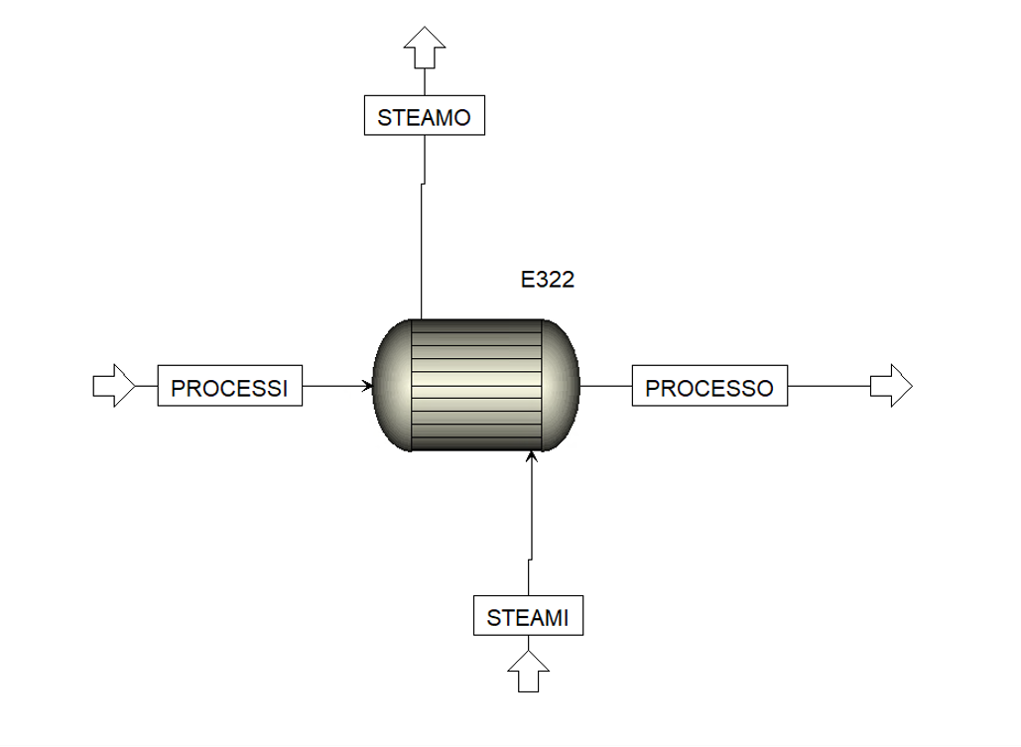
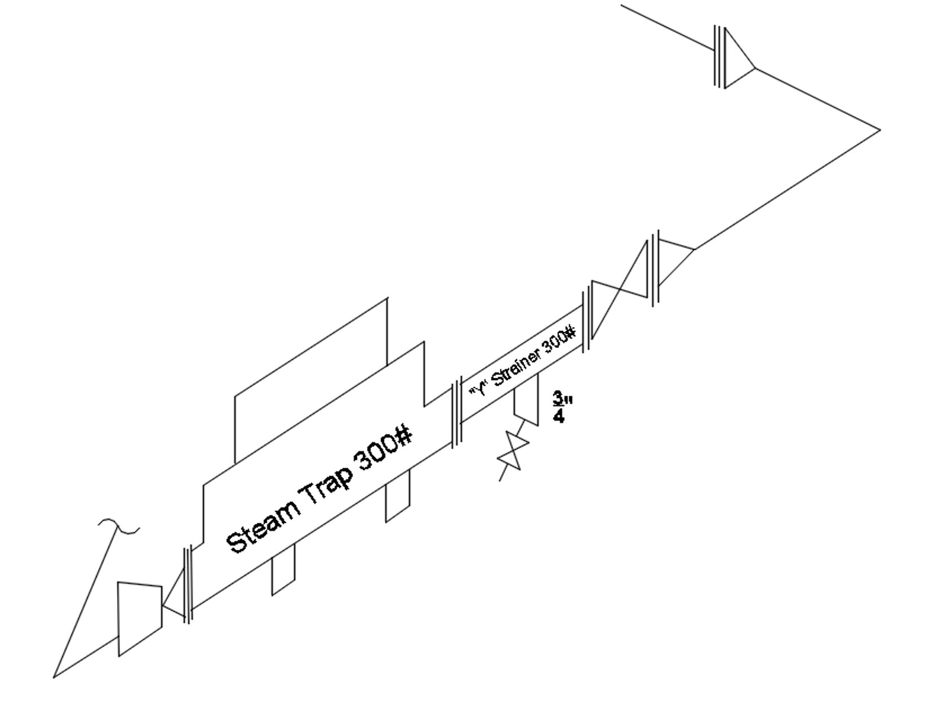
Design Progress to Date
Speaker: Curtis
Figure 1: Aspen Model of Heat Exchanger
Figure 2: Isometric Drawing of Steam Trap Design
10

Slide 11
03
Technical Analysis
11

Slide 12
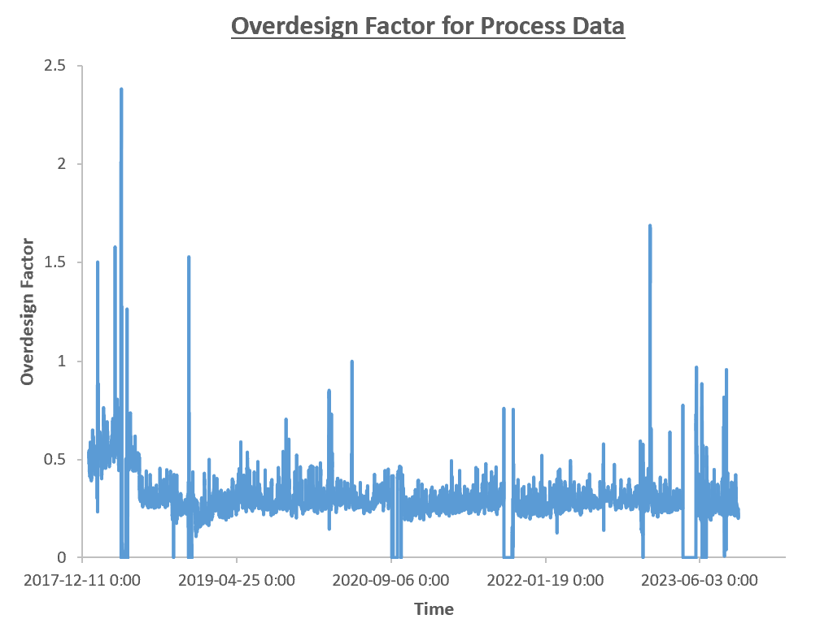
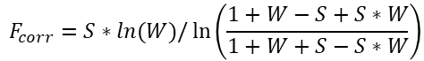
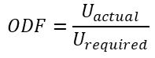
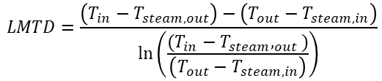
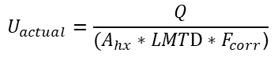
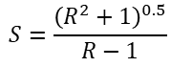
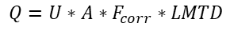
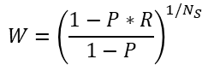
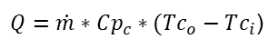
Technical Analysis
Speaker: Curtis
Design Calculations
(1)
$$LMTD=\frac{\left(T_{in}−T_{steam,out}\right)−\left(T_{out}−T_{steam, in}\right)}{\ln\left(\frac{(T_{in}−T_{steam},_{out})}{\left(T_{out}−T_{steam, in}\right)}\right)}$$
(2)
$$F_{corr}=S∗ln(W)/\ln\left(\frac{1+W−S+S∗W}{1+W+S−S∗W}\right)$$
(2a)
$$W={\left(\frac{1−P∗R}{1−P}\right)}^{1/N_{S}}$$
(2b)
$$S=\frac{{\left(R^{2}+1\right)}^{0.5}}{R−1}$$
(3)
$Q=\dot{m}∗Cp_{c}∗(Tc_{o}−Tc_{i}$)
(4)
$$Q=U∗A∗F_{corr}∗LMTD$$
(5)
$$U_{actual}=\frac{Q}{(A_{hx}∗LMT\text{D}∗F_{corr}\text{)}}$$
Figure 3: Overdesign Factor versus Time Plot
(6)
$$ODF=\frac{U_{actual}}{U_{required}}$$
12

Slide 13
Technical Analysis
Speaker: Ricky
Raw Data
Initial Thresholding
Prophet Prediction
Identify sections of interest
Forecasting prediction
Secondary Thresholding (Data Smoothing)
Overlay sections of interest
Figure 4: Algorithm Flow Chart
13
Notes:
This flowchart details the process of the algorithm followed to determine the optimal cleaning schedule.
The raw data is first treated to remove extreme outliers via the initial thresholding
Following the first leg, the software library, Prophet, is then applied to the dataset, and the trends and changepoints on the correction factor are identified
From this, the sections of interest can be determined
The trend of the correction factor is then predicted from the model built by Prophet and displayed graphically, which will be seen shortly
On the second leg, the heat duty is analyzed, and is further thresholded by a data smoothing algorithm.
The sections of interest from the first section are then overlaid onto the heat duty dataset to validate the effects of a decreasing correction factor.

Slide 14
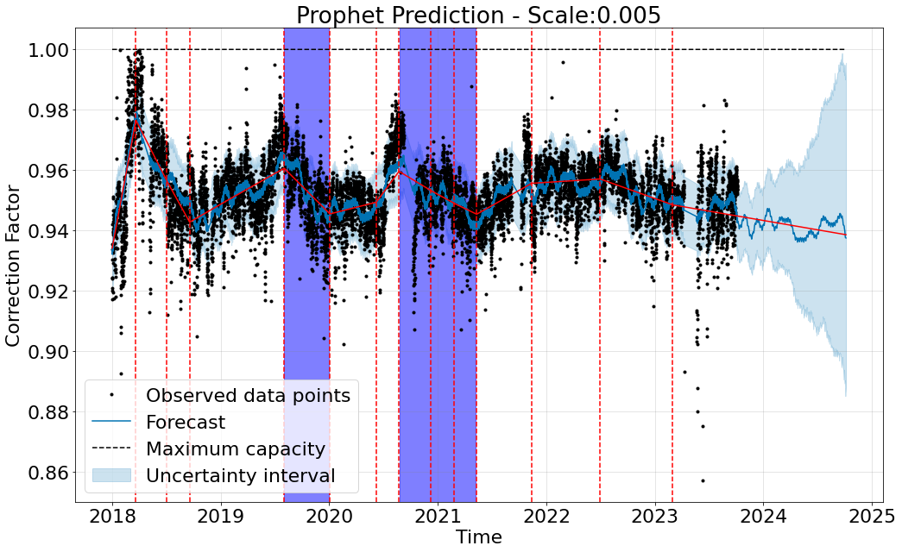
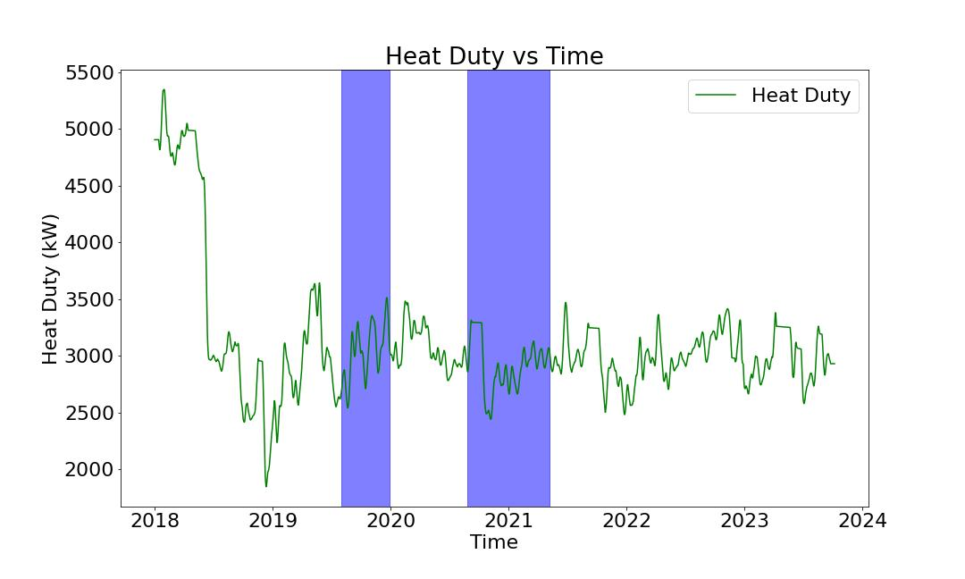
Technical Analysis
Speaker: Ricky
Figure 5: Prophet Prediction of Correction Factor versus Time
Figure 6: Heat Duty Values versus Time
14
Notes:
The following two figures are the correction factor and the heat duties calculated from the provided dataset
The dataset which was analyzed ended around Q3 of 2023.
Within Figure 5, the black data points are the raw data, the red data series is the trend, the blue data series is the predicted point value, the light blue shaded regions are the regions of interest, and the red vertical dashed lines are the changepoint indicators. These may indicate a change in parameters within the dataset. For example, the first changepoint was triggered by a change in process fluid within the heat exchanger.
Figure 6 illustrates the heat duty transferred within the heat exchanger. With the regions of interest overlaid, the trend of decreasing correction factor indicates an increase in heat duty.
When both the correction factor and heat duty exceed a threshold, this will indicate a cleaning is required.

Slide 15

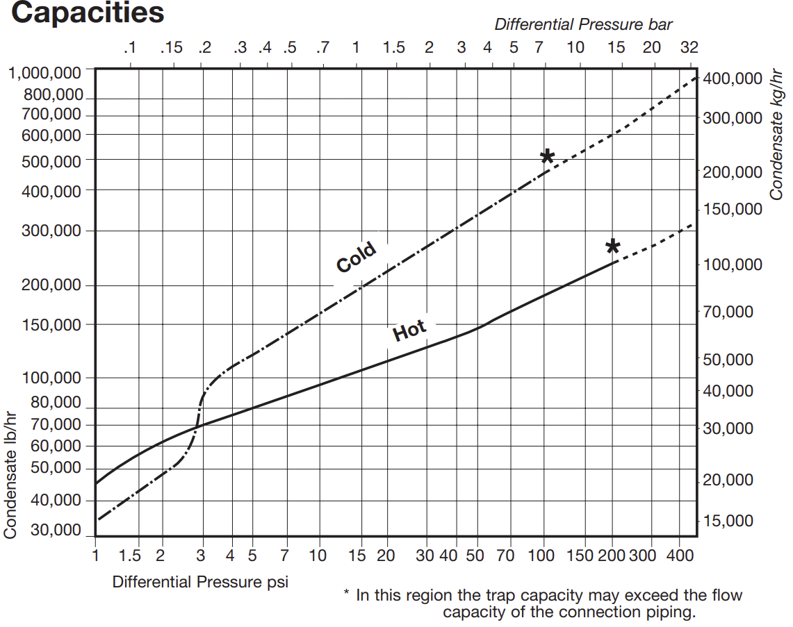
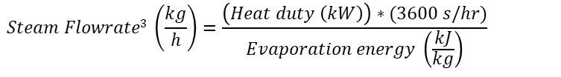
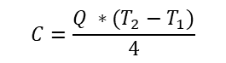
Technical Analysis
Speaker: Dorothy
Design Calculations
Assumptions
The type of steam trap is Float & Thermostatic
Steam rating of 175# is used as a pressure of 175 psi for steam trap sizing.
$$C=\frac{Q ∗(T_{2}−T_{1})}{4}$$
(7)
C: Condensate load (kg/hr)
Q: Quantity of being heated (L/min)
T₁: Initial temperature of liquid being heated
T₂: Final temperature of liquid being heated
Knowing the typical Safety Load Factors for Float & Thermostatic is 2 to 1
(8)
$$Desired Trap Capacity=Condensate Load∗Safety Load Factor$$
(9)
$$Steam Flowrate3 \left(\frac{kg}{h}\right)=\frac{\left(Heat duty \left(kW\right)\right)∗(3600 s/hr)}{Evaporation energy \left(\frac{kJ}{kg}\right)}$$
Figure 7: Spirax Sarco FT450 – Sizing Capacity Data¹
1. https://www.statesupply.com/media/filemanager/2/7/2756.pdf
15
Notes:
During the technical analysis, some assumptions were made for the steam trap calculations and sizing process.
The first was to assume that the type of steam trap is a float and thermostatic.
This determined the capacities needed to size the steam trap using Figure 7 from the data sheet for a Spirax Sarco steam trap, a commonly used equipment vendor.
Based on a steam rating of 175 lbs, an assumption was made to determine the differential pressure to be 175 psi.
The condensate load was determined by using the quantity of liquid being heated in the heat exchanger, and the initial and final temperatures. This allowed us to determine that the steam trap size should be 3” or 4”.
The desired trap capacity was calculated by using the condensate load as well as the safety load factor which is determined to be 2 to 1 for float and thermostatic steam traps.
Finally, the steam flowrate is calculated using the heat duty of the heat exchanger and the evaporation energy of the fluid used. These calculations were repeated for the data spanning from years 2018 to 2023.

Slide 16
Technical Analysis
Speaker: Dorothy
Constraints | Solution Satisfaction
Sustainable No negative impacts when design is implemented | The steam trap will trap any pollutants in the stream exiting the heat exchanger to allow for safe disposal. An optimized cleaning schedule would also reduce the amount of pollutants in the waste stream used to clean it
Long Lasting Lifetime must be within or exceed five to ten years of applicability | The optimized cleaning schedule will provide optimal shutdown dates and determine when the cost of lost production has been limited due to drop-offs in thermal efficiency
Operational Safety Maintaining an overdesign factor of 0.5 with the implemented solution | The optimized cleaning schedule provides analysis of actual overall heat transfer coefficients compared to the required heat transfer coefficients.
16
Notes:
Our solution satisfies all three of our constraints, sustainable, long lasting, and operational safety.
For the first constraint, the steam trap in our design will trap any pollutants that may enter the process and allow for safe disposal without causing additional downtime or issues with the rest of the process. The optimized cleaning schedule will reduce the amount of pollutants in the air and wastewater stream as there is less build up to clean.
It is expected that our solution will have a lifetime within or exceeding 5 to 10 years. The optimized cleaning schedule provides optimal shutdown intervals which is determined from reducing the costs of lost production and the drop offs in thermal efficiency due to fouling build-up.
The final constraint, operational safety, is satisfied through our calculations of the overdesign factor. The optimized cleaning schedule provides analysis of the actual overall heat transfer coefficients compared to the required heat transfer coefficients.
Based on current data, we have achieved an overdesign factor of 0.5 but if time permits, we will be working to achieve a factor of 1.1.

Slide 17
04
Impacts Analysis
17

Slide 18
Impacts Analysis
Speaker: Dorothy
Environmental Impacts
Less frequent cleanings result in an increase in wastewater and air pollutant concentrations
Petroleum refineries follow the technical standard for air quality under Regulation 419/05¹
Regulations in Ontario include the Ontario Water Resources Act² and the Environmental Protection Act³
To ensure FoulX has no negative impacts, the amount of pollutants can be related to the heat duty of the heat exchanger
Economical Impacts
Using PetroCanada’s given data for a potential shutdown in July 2019, one could perform a cost analysis⁴:
If FoulX were to reduce the downtime to 21 days, it would lead to a significant decrease in the economic impact of fouling on heat exchangers in Mississauga Lubricants Facility. The $2M reduction in downtime costs would positively affect the facility's bottom line and improve its overall financial performance.
Baseline Analysis (2019) – Lose 31 Production Days:
Maintenance Costs: $900,000
Cost of Downtime: $200,000 per day
Total Economic Impact (2019):
Maintenance Costs: $900,000
Downtime Costs: $6,200,000
Total Impact: $7,100,000
Scenario Analysis - Reduced Downtime (21 days):
Downtime Costs: $4,200,000
Total Economic Impact with Reduced Downtime:
Maintenance Costs: $900,000
Downtime Costs (Reduced): $4,200,000
Total Impact: $5,100,000
1. https://www.ontario.ca/document/technical-standards-manage-air-pollution-0/petroleum-refining-industry-standard
2. https://www.ontario.ca/laws/statute/90o40#BK56
3. https://www.ontario.ca/laws/statute/90e19
4. 2019 Tech Talk – Fall 2018 Dewax Outage to Clean DWO Recovery Exchangers
18
Notes:
Next are the environmental and economical impacts of our solution.
When the heat exchanger is not cleaned frequently there is an increase in wastewater needed to clean the fouling off the heat exchanger during the routine shutdowns. It can also result in an increase in air pollutants as the heat exchangers must be pressure washed to effectively remove the fouling
In Ontario, petroleum refineries are required to follow the technical standard for air quality under regulation 419/05
Other regulations concerning the wastewater and air pollution, are the ontario water resources act and environmental protection act
To ensure foulX has no negative impacts, the amount of pollutants can be related to the heat duty of the heat exchanger.
Optimizing the cleaning schedule would result in a lower concentration of pollutants as the amount of build up being cleaned from the heat exchanger would be reduced.
From the data given by Petrocanada, the projection of the economical impact of reducing the downtime by an estimate of ten days would result in a total impact of 5 million 100 thousand dollars lost due to downtime. In comparison to the economic impact of 21 days of 7 million 100 thousand dollars.
This significant decrease of two million dollars in economic impact of fouling in heat exchangers in the Mississauga lubricants facility would positively affect the facility’s bottom line and improve its overall financial performance.

Slide 19
05
Remaining Work
19

Slide 20
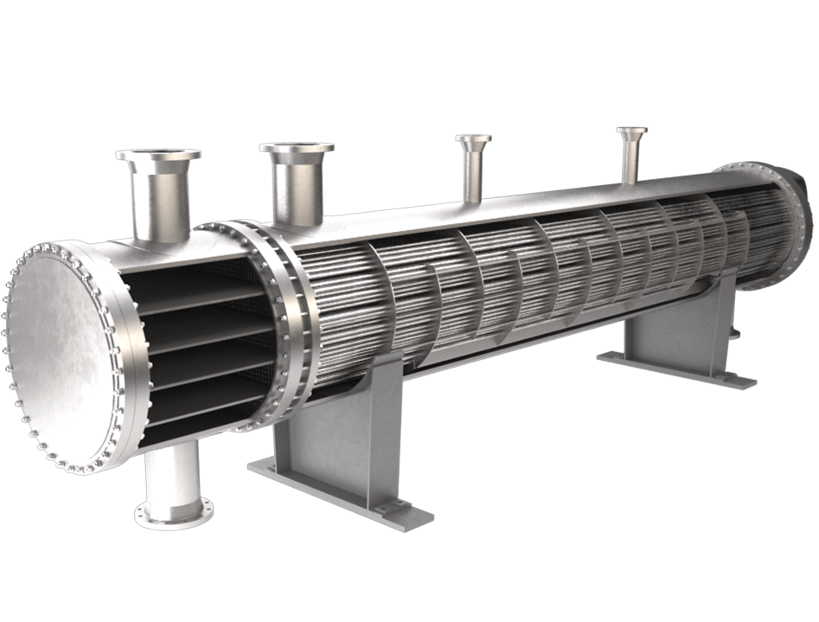
Remaining Work
Speaker: Curtis
Final resolution of cleaning schedule (Ricky and Curtis)
Design and write function to analyze thresholds of heat duties (Ricky)
Impact Analysis (Dorothy and Aliana)
Symposium Poster Completion (Aliana)
Report Completion (Aliana, Curtis, Dorothy, Ricky)
Environmental Impact (Dorothy)
Economical Impact (Aliana)
Health and Safety Impact – HAZOP (Ricky & Curtis)
20

Slide 21
Thanks for Watching!
Speaker: Curtis
Do you have any questions? Contact us!
Aliana Andres: arandres@uwaterloo.ca
Dorothy Wan: d8wan@uwaterloo.ca
Curtis Rhodes: curtis.rhodes@uwaterloo.ca
Ricky Fan: ricky.fan@uwaterloo.ca
21

